Slide 1
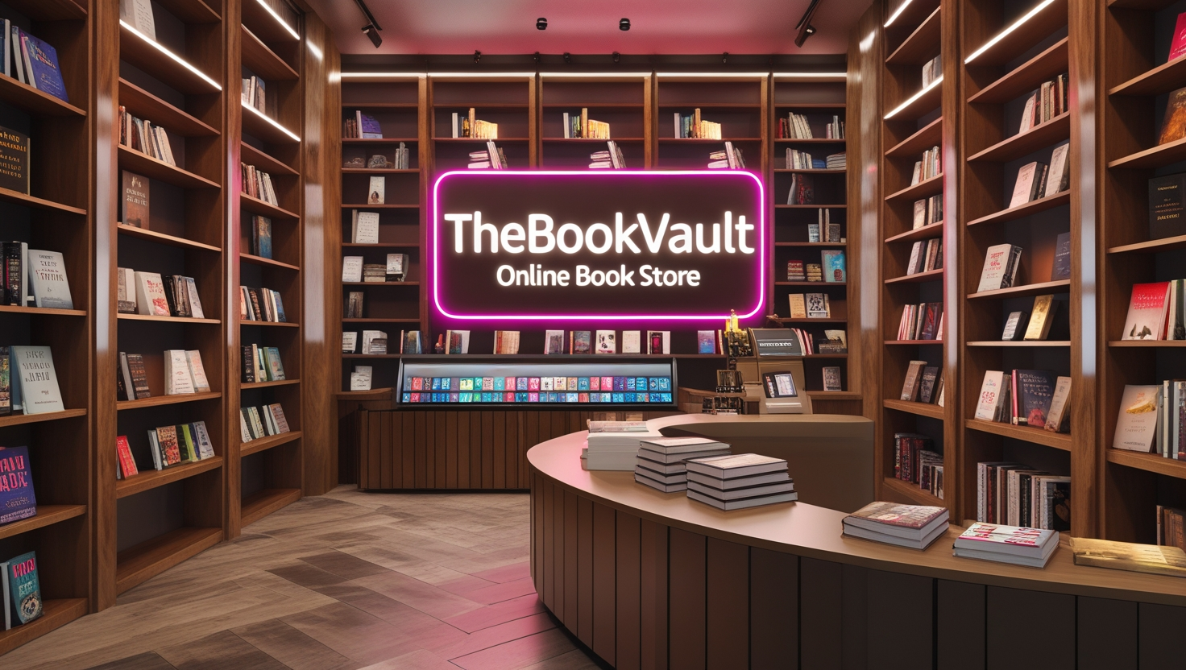

Slide 2
Basic Queries
1) Retrieve all books in the "Fiction" genre
2) Find books published after the year 1950
3) List all customers from the Canada
4) Show orders placed in November 2023
5) Retrieve the total stock of books available
6) Find the details of the most expensive book
7) Show all customers who ordered more than
1 quantity of a book
8) Retrieve all orders where the total amount exceeds $20
9) List all genres available in the Books table
10) Find the book with the lowest stock
11) Calculate the total revenue generated from all order
Advance Queries
Retrieve the total number of books sold for each genre
Find the average price of books in the "Fantasy" genre
List customers who have placed at least 2 o
Find the most frequently ordered book 5)
Show the top 3 most expensive books of 'Fantasy' Genre
Retrieve the total quantity of books sold by each author
List the cities where customers who spent over $30 are located
Find the customer who spent the most on orders
Calculate the stock remaining after fulfilling all order

Slide 3
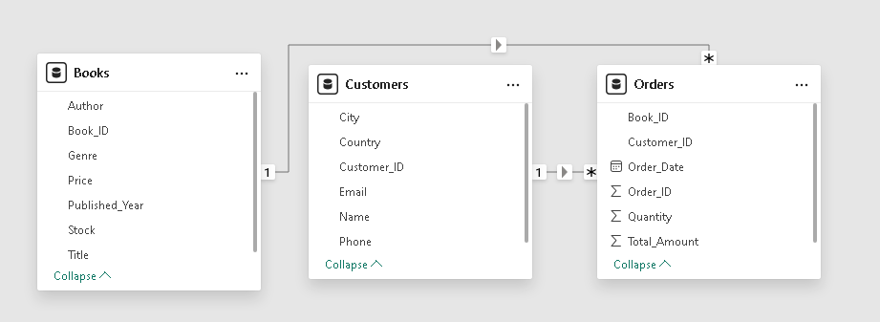
Schema Of This Database

Slide 4
Key Insights Extracted
Genre Popularity: Fiction emerges as the most popular genre, indicating a strong reader preference and potential for targeted promotions.
Sales Trends: A significant portion of book sales comprises publications released after 1950, reflecting a market inclination towards modern literature.
Customer Demographics: A considerable customer base exists in Canada, presenting an opportunity for region-specific marketing strategies.
Seasonal Demand: A spike in orders during November 2023 suggests a seasonal sales pattern, useful for future sales forecasting and stock planning.
Stock and Pricing Insights: The most expensive book and the lowest stock items highlight the importance of dynamic pricing and inventory management.
Repeat Customers and Engagement: Customers who have placed multiple orders indicate a loyal customer base, which can be leveraged through engagement initiatives.
Author and Book Performance: Certain books and authors significantly outperform others, providing valuable data for procurement and marketing decisions.
8. Revenue and Profitability: The total revenue generated gives a clear picture of the bookstore’s financial health, aiding in strategic decision-making.

Slide 5
Recommendations to Stakeholders
Sales Trends: A significant portion of book sales comprises publications released after 1950, reflecting a market inclination towards modern literature.
Customer Demographics: A considerable customer base exists in Canada, presenting an opportunity for region-specific marketing strategies.
Seasonal Demand: A spike in orders during November 2023 suggests a seasonal sales pattern, useful for future sales forecasting and stock planning.
Stock and Pricing Insights: The most expensive book and the lowest stock items highlight the importance of dynamic pricing and inventory management.
Bulk and High-Value Purchases: A notable number of customers place bulk orders and make purchases exceeding $20, emphasizing the potential for loyalty programs and premium offerings.
Repeat Customers and Engagement: Customers who have placed multiple orders indicate a loyal customer base, which can be leveraged through engagement initiatives.
7. Author and Book Performance: Certain books and authors significantly outperform others, providing valuable data for procurement and marketing decisions.
8. Revenue and Profitability: The total revenue generated gives a clear picture of the bookstore’s financial health, aiding in strategic decision-making.

